Slide 1


Data science for service change
Presented by DataSF | datasf.org/science
City and County of San Francisco

Slide 2



What is data science?
Data Science
Applying advanced statistical tools to existing data to generate new insights
Service Change
Converting new data insights into (often small) changes to business processes
Smarter Work
More efficient and effective use of staff and resources

Slide 3
What complements data science?
(and is really good stuff to do)
Approach
Process
Outcome
Examples
Performance Management
Define, visualize, often using dashboards, and manage to KPIs
Meet goals and KPI targets
SF Scorecard, PublicWorks Stat & Stat starter kit
Evaluation
Assess a project, program or policy design or results
Better investment of resources; Better policy decisions
Evaluation of transitional-kindergarten in SF
Policy Analysis
Define and assess alternatives using a broad range of tools
Report or memo with policy or program recommendations
Shape Up SF Policy Analysis
Open Data
Publish civic data for use by the City and the public
Easier data sharing and reporting, new tools or services built on data
SFPUC Adopt a Drain
DataScienceSF
Identify insights using advanced statistics tied to a service change
Smarter work “on the ground” in real time
See rest of deck!

Slide 4
What complements data science?
(and is really good stuff to do)
Approach
All approaches can lead to service improvement. It’s about choosing the right tool for the job (and sometimes combining them)!
Performance Management
Evaluation
Policy Analysis
Open Data
DataScienceSF

Slide 5
What’s in the DataScienceSF Toolkit?
Statistical Methods
Tools
User Experience Research
Sentiment analysis
Time series analysis
Data mining
Multilevel modeling
Missing data imputations
Classification and clustering
Survival analysis
Pattern recognition
Principal component and factor analysis
AB testing
Machine learning
Forecasting
Propensity score matching
Logistic, multinomial and multiple linear regression techniques
Network analysis

Slide 6
What’s in the DataScienceSF Toolkit?
Statistical Methods
Tools
User Experience Research
Languages
Python
R
SQL
Javascript
NodeJS
Libraries
SciPy
Pandas
Scikit-learn
GPText
OpenNLP
Mahout
+many others
Data Engineering
Profiling
ETL
Job notices
APIs
Optimized data pipelines
Optimized data storage/access
Visualization
D3.js
Gephi
R
Leaflet
PowerBI
ggplot2
shiny

Slide 7
What’s in the DataScienceSF Toolkit?
Statistical Methods
Tools
User Experience Research
Iterative Prototyping
Photo journaling and documenting
Service blueprinting
Journey mapping
Ride-alongs
Process mapping
Ethnographic field research and user observation
Usability testing

Slide 8






What is NOT data science?
 This
 Not that
Service change
Academic research
Major overhauls / service disruptions
Small changes
Collecting new data (mostly ;)
Use existing data

Slide 9
Data Science
Project Types

Slide 10






Project Type: Find the needle in the haystack
What to target?
Data Science
Service Change
Target areas
Target categories
Target individuals
Service Issue:
Difficult to identify targets in a population
Data Science Process:
Use existing data and predictive modeling to identify targets
Service Change:
Engage with target subset of population
Result: Department resources are spent where most needed

Slide 11




Examples: Free fire alarms in New Orleans
Service Issue
Fire alarms to homes that have them
Data Science
ID homes with high prob. of no alarm
Service Change
Use list to shape outreach
Result
2x increase in hit rate
Notes:
Image source: https://www.flickr.com/photos/techy2610/
https://www.flickr.com/photos/usag-yongsan/

Slide 12
Examples: Find the needle in the haystack
Service Issue
Data Science
Service Change
Result
New Orleans Fire Department (Nola FD) distributes free fire alarms to homes. But many homes they visited already had them, wasting Nola FD’s resources.
Nola’s analytics team used public data to identify homes with a high probability of not having a fire alarm and provided Nola FD with a list.
Nola FD used the list to determine where to offer fire alarms.
With no increase in resources or patrols, Nola FD increased the hit rate of homes needing smoke alarms by 2x.
New Orleans Fire Alarms
New York City (NYC) conducts corporate tax audits. They are time consuming and 37% have no findings. They want to increase findings but maintain their number of audits.
NYC analyzed historical audit records and identified patterns of businesses. Outliers were flagged as possible audit targets.
The audit team targeted the flagged cases for audits.
With the same staff levels, the audit team decreased the percent of cases with no finding from 37 to 22%, leading to increased revenues.
New York City Tax Compliance
Notes:
Source: NOLA Office of Performance Analytics
Source: Data-Smart City Solutions

Slide 13

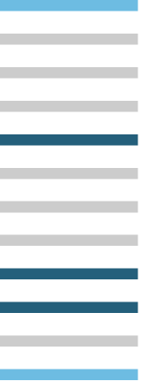

Project Type: Prioritize your backlog
What to prioritize?
Data Science
Service Change
Service Issue:
Backlog is tackled via first in, first out (FIFO)
Data Science Process:
Create a model to categorize and group past and current cases
Service Change:
Prioritize cases based on categories in order of risk, need or opportunity
Result: Department addresses high priority cases first

Slide 14

Examples: Blight backlog in New Orleans
Service Issue
Backlog in blight enforcement
Data Science
Use data to grade cases per prior decisions
Service Change
Result created abatement tool
Result
1500+ case backlog gone in 100 days
Notes:
Image Source: https://www.flickr.com/photos/new_orleans_strata/

Slide 15
Examples: Prioritize your backlog
Service Issue
Data Science
Service Change
Result
In Boston, they have a large list of residences with anti-social complaints filed against them.
The analytics team pooled data from housing, police, and tax agencies to gauge the nature of complaints and identify the biggest contributors to complaints.
The Air Pollution Control Commission expedited enforcement with the biggest contributors.
With no change in resources, Boston saw a 55% reduction in police calls associated with the targeted residences.
Boston Complaints
New Orleans (Nola) faced a significant backlog in blight enforcement due in part to bottlenecks in the decision making process and missing information.
Nola used data on the outcomes of previous blight cases to grade cases in the backlog and to recommend additional data to collect by field teams.
The enforcement team used the results as an abatement decision tool to speed the decision-making process of whether to demolish or foreclose a home.
Nola eliminated the 1,500+ case backlog in less than 100 days.
New Orleans Blight
Notes:
Source: Ash Center
Source: Data-Smart City Solutions

Slide 16



Project Type: Flag “stuff” early
How to detect?
Data Science
Service Change
Service Issue:
Hard to predict future condition which leads to reactive services
Data Science Process:
Use historical and current data to create estimate ranges for potential outcomes
Service Change:
Use estimates to change and tailor intervention points
Result: Department provides pro-active early interventions

Slide 17

Examples: Use of force alerts in Charlotte
Service Issue
Excessive force have neg. impact on community
Data Science
Identify patterns to refine early warning
Service Change
Flagged recurring complaints
Result
Accuracy up 20%; False positives down 55%
Notes:
Image Source: https://www.flickr.com/photos/kenfagerdotcom/

Slide 18
Examples: Flag “stuff” early
Service Issue
Data Science
Service Change
Result
Excessive force violations by police officers have huge negative repercussions in the community and for police careers.
The analytics team refined an early warning system, identifying patterns that often led to officers having negative interactions with the public.
The department flagged recurring complaints against officers and notified supervisors when certain thresholds were reached.
The CMPD system increased accuracy by 15-20% while reducing false positives by 55%.
Charlotte Police Violence
In Chicago, a large number of children are thought to be exposed to lead paint in older houses.
The analytics team built a model of exposure using data on homes, history of children’s exposure at that address and conditions of neighborhood.
They conducted targeted inspections and provided remediation funding to homes identified in the model.
Chicago reached the most vulnerable families before severe health effects from lead contamination manifest.
Lead Poisoning in Chicago
Notes:
Source: Data Science for Social Good
Source: Data Science for Social Good

Slide 19
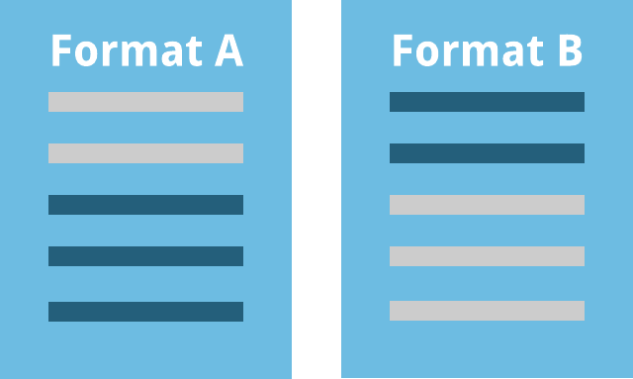

Project Type: A/B test something
Which form?
Data Science
Service Change
62%
respond
78%
respond
Service Issue:
Costly outreach methods are not tested before implementation
Data Science Process:
Statistical testing on outreach methods to identify which, when, and to whom to send
Service Change:
Use statistically validated outreach method
Result: Department increases response rates

Slide 20
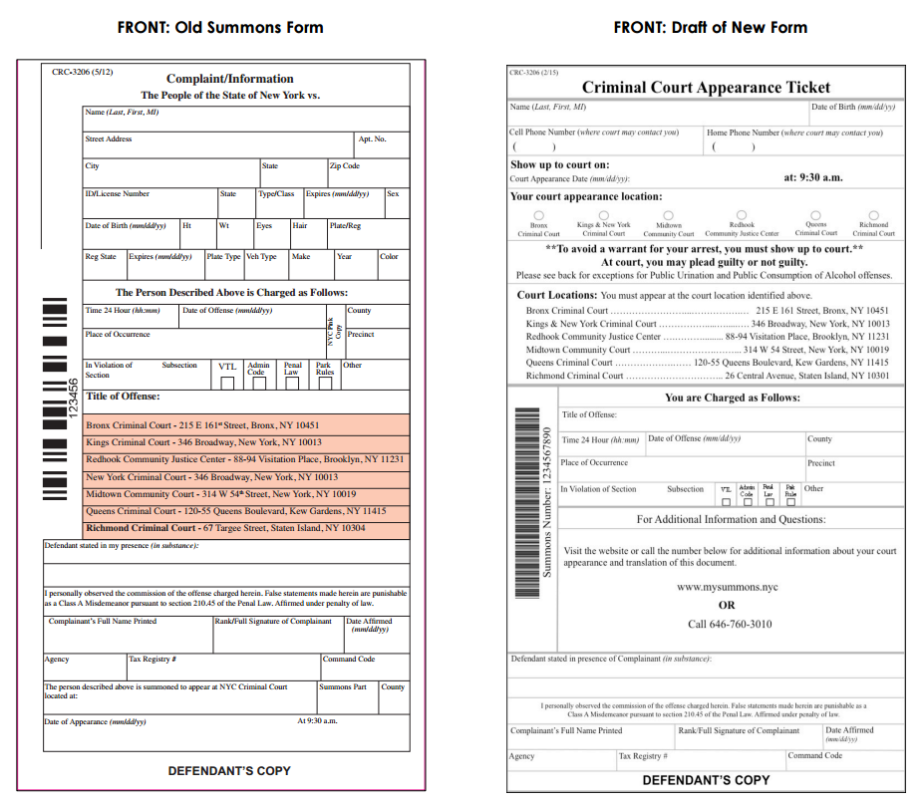
Examples: NYC Summons Redesign
Service Issue
40% cited no-show leading to costly arrest
Data Science
Redesigned and tested summons form
Service Change
Deployed new form and rescheduled timelines
Result
Currently evaluating impact
Notes:
Image Source: http://www.ideas42.org/blog/project/nypd-summons-redesign/

Slide 21
Examples: A/B test something
Service Issue
Data Science
Service Change
Result
In New Orleans, they have a low take up rate of free primary care appointments.
The analytics team tested different SMS reminders to those eligible for appointments.
The department implemented the most successful SMS text.
60% increase in clients using free primary care appointments
NOLA Community Health Program
40% of those cited for low-level violations did not take required next steps, leading to issuance of arrest warrants.
Experiment and test redesign of summons process
Reschedule court timelines to facilitate greater access
Evaluating impact on use of costly arrest warrants (Project currently in progress)
NYC Summons Redesign
Notes:
Source: NOLA Office of Performance Analytics
Source: Ideas42

Slide 22
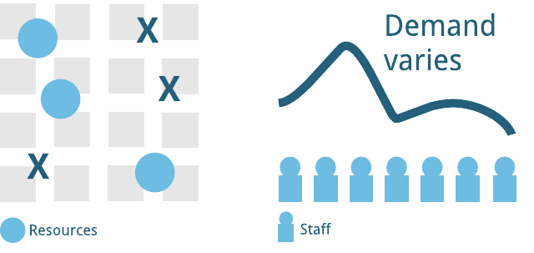


Project Type: Optimize your resources
How to distribute?
Data Science
Service Change
Service Issue:
Difficult to identify where to place or distribute resources to be most effective
Data Science Process:
Use geospatial and/or other data to identify optimal distribution of resources
Service Change:
Re-allocates resources to optimal distribution
Result: Department decreases response times; increases volume

Slide 23
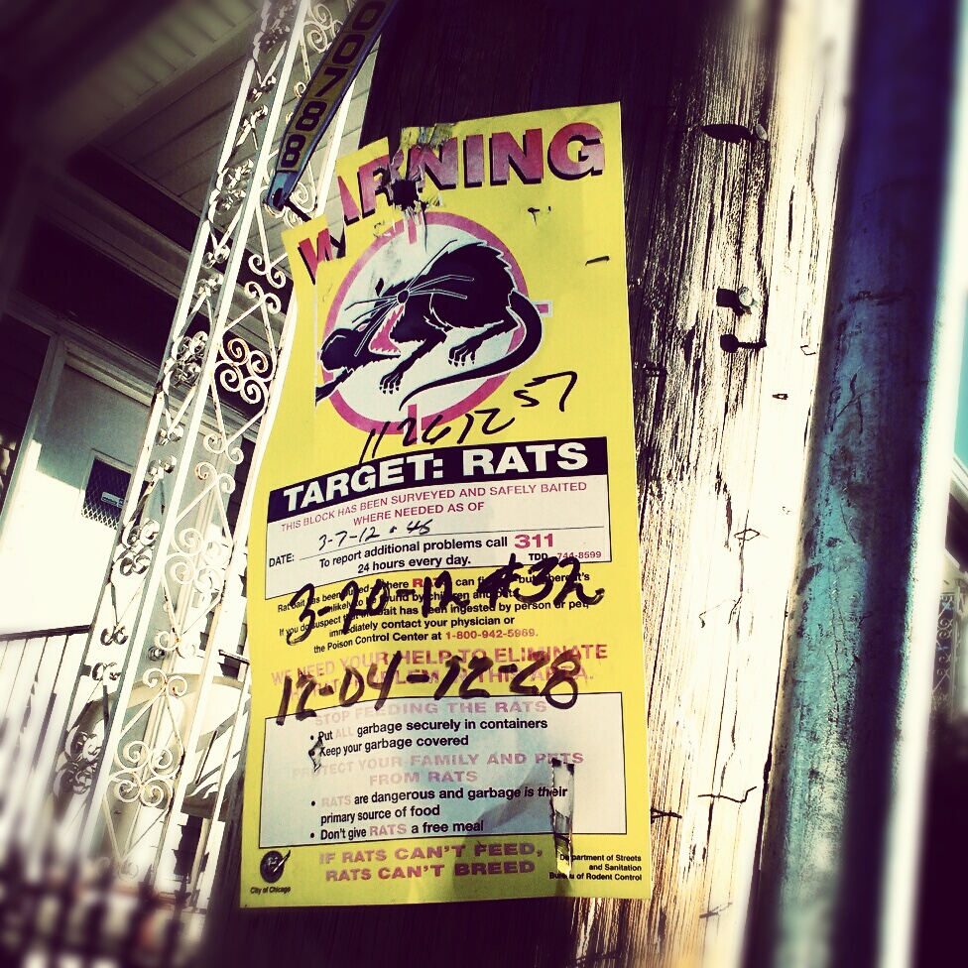
Examples: Chicago Pest Control
Service Issue
Challenging to predict outbreaks
Data Science
Analyze data associated with outbreaks
Service Change
Proactive targeting of leading indicators
Result
15% drop in requests for service
Notes:
Image Source: https://www.flickr.com/photos/65172294@N00/

Slide 24
Examples: Optimize your resources
Service Issue
Data Science
Service Change
Result
Chicago’s rodent baiting program finds it challenging to predict rodent outbreaks and locations leading to spikes in 311 complaints.
Predicted potential danger of outbreaks by using leading indicators and other data correlated with previous outbreaks.
Directed rodent baiting to areas identified by leading indicators, including events, like water main breaks.
Resident requests for rodent control services dropped by 15%
Chicago Pest Control
In New Orleans, ambulance standby locations are chosen based on dispatcher habits or instincts.
Analytics team used city wide analysis of data on accident patterns, traffic patterns, and crew readiness to identify optimal standby locations
Ambulances deployed at new optimized locations
Targeting short response times to EMS calls (Project currently in progress)
NOLA Ambulance Stand-by Location
Notes:
Source: Data-Smart City Solutions
Source: NOLA Office of Performance Analytics

Slide 25
What was the service change?
 From that
 To This
Fire Alarms
Random List
Prioritized List
Blight
Staff evaluates all cases
Tool evaluates easy cases
Early Warning
Focus on that set of officers
Focus on this set of officers
Summons
Send Original Form
Send new form
Control
Arrive at location X too late
Arrive at location X early
Service Change = Small Business Process Change

Slide 26




Summary: The five project types
Find the needle in the haystack
Prioritize your backlog
Some combination
Flag “stuff” early
A/B test something
Optimize your resources
Something else…

Slide 27
DataScienceSF
Cohort 1

Slide 28








ASR: Increase property tax revenues
Service Issue
When a property sells in SF, we either accept the sales price or modify it to collect property taxes. So which sales should you accept and which should you dig into?
Data Science
Our regression model identifies which sale prices are unusual for the location, time and property details
Service Change
http://www.markersf.com/blog/
The model splits properties into two lists: normal sale prices to enroll directly in tax collection and outlier sales for manual review by appraisers
Result
Expected: Increased revenue and time to revenue, reduced backlog, and more consistency in assessments
Prioritize your backlog
Notes:
Image source: https://www.flickr.com/photos/techy2610/
https://www.flickr.com/photos/usag-yongsan/

Slide 29
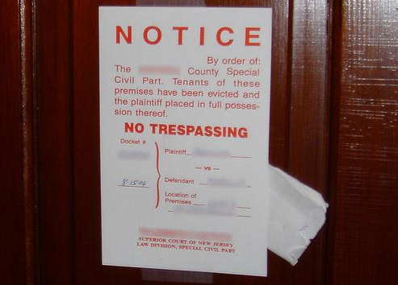

Evictions: Pro-actively prevent evictions
Service Issue
How can we make eviction prevention more proactive by identifying the most problematic eviction notices in real time?
Data Science
An algorithm combines data sources to identify eviction notice filings that are outside the norm
Service Change
A list of flagged eviction notices is sent to eviction prevention services to proactively review for service outreach
Result
Expected: Targeted eviction prevention that keeps residents in their homes
Find the needle in the haystack
Flag “stuff” early
Notes:
Image source: https://www.flickr.com/photos/techy2610/
https://www.flickr.com/photos/usag-yongsan/

Slide 30

ENV: Find new clients to help green our City
Service Issue
SF Environment offers financial incentives and technical assistance to help our constituents upgrade their lighting & refrigeration systems. But their list of leads is dwindling - how can they find new leads?
Data Science
Mashed together multiple data sources to identify characteristics of stronger leads
Service Change
New and longer list of property leads with enriched data for targeting marketing campaigns
Result
Expected: New customers and increased uptake of green subsidies
Find the needle in the haystack
Optimize your resources
Notes:
Image source: https://www.flickr.com/photos/techy2610/
https://www.flickr.com/photos/usag-yongsan/

Slide 31

DPH WIC: Help moms and babies stay in nutrition program
Service Issue
Since 2011, DPH has seen an increase in mothers dropping out of their nutrition program. Which moms are most at risk of dropout?
Data Science
Built a predictive model that identified moms and infants who are at greatest risk for dropping out
Service Change
Using the high-risk client profiles to conduct targeted interviews to identify program barriers and make service changes
Result
Expected: Reduce the dropout rate of moms, infants and children, leading to healthier outcomes for both
Flag “stuff” early
Notes:
Image source: https://www.flickr.com/photos/techy2610/
https://www.flickr.com/photos/usag-yongsan/

Slide 32

DPH BHS: Improve results and reduce costs in mental health care
Service Issue
A small fraction of mental health patients use a large % of resources. Can we identify high users early to improve their outcomes and reduce costs?
Data Science
Build predictive model to identify clients at greatest risk for becoming high users
Service Change
Expected: Targeted service model to direct high users to more stable and preventative services
Result
Expected: Reduction in high cost clients and use of high cost emergency services
Find the needle in the haystack
Flag “stuff” early
Notes:
Image source: https://www.flickr.com/photos/techy2610/
https://www.flickr.com/photos/usag-yongsan/

Slide 33

MYR: Increase community input for Fix-It
Service Issue
Fix-It needs to hear from a wide range of folks to ensure their fixes meet the needs of most residents. How can they increase the number of people who provide input?
Data Science
Test a new, behaviorally informed flyer compared to the existing flyer
Service Change
Use whichever flyer gets the best response
Result
Expected: Increase number of survey respondents and attendees for community meeting, leading to better input
A/B test something
Notes:
Image source: https://www.flickr.com/photos/techy2610/
https://www.flickr.com/photos/usag-yongsan/

Slide 34

ART: Preserve City art for the future
Service Issue
The Arts Commission needs to accurately and efficiently project long-term costs to budget for art preservation
Data Science
Revised cost formula and new tool to provide long-term projections and prioritization of conservation projects on demand
Service Change
Use tool to model cost scenarios instead of manual, one time process
Result
Expected: Reduction in staff time, more accurate cost estimates, and earlier identification of pieces in need of conservation
Optimize your resources
Notes:
Image source: https://www.flickr.com/photos/techy2610/
https://www.flickr.com/photos/usag-yongsan/

Slide 35
Overview of Phases
Cohort 2: Jan – June
Solicitation
Selection
Project refining
Present
Oct - Nov
Nov 22
Nov 27 – Dec 13
Dec 13
Dec
January - May
June
Application due
Notify applicants
Analysis & service change
Cohort 3: June – Dec
Solicitation
Selection
Project refining
Present
April - May
May
May
MidMay
June
July - November
Dec
Application due
Notify applicants
Analysis & service change

Slide 36
Phase: Solicitation
Opportunities to learn more
Brown bags
Office hours
Invited presentations
Dates at datasf.org/science
April - May
May
May
MidMay
June
July - November
Dec

Slide 37
Phase: Solicitation
How to prepare
Brainstorm projects using the project types
Identify possible service changes
Review data that could help
Identify key staff members
Learn more at datasf.org/science
April - May
May
May
MidMay
June
July - November
Dec

Slide 38
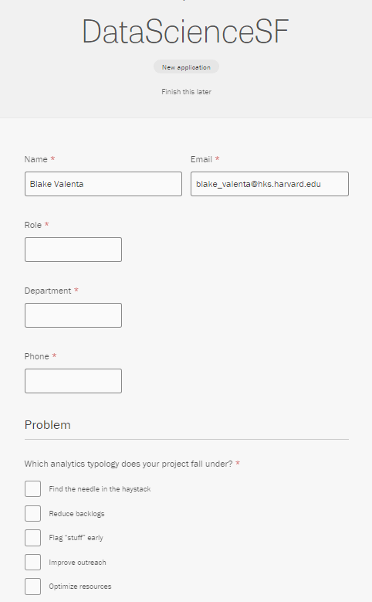
Phase: Application
Available at datasf.org/science
Brief online form
Problem statement (200 word max)
Impact statement (100 words max)
Service change statement
Data overview
Project champion
April - May
May
May
MidMay
June
July - November
Dec

Slide 39
Phase: Application
Criteria to keep in mind
Above all else: A viable path to service change
Question / problem answerable by data science
Solvable within cohort time frame
Impact
Department commitment
Data readiness
April - May
May
May
MidMay
June
July - November
Dec

Slide 40
Phase: Selection
Process
Initial review
Criteria assessment
Application scoring
Department follow-ups, as needed
Be available for questions (email or in person)
Estimating 5-10 projects per Cohort
April - May
May
May
MidMay
June
July - November
Dec

Slide 41
Phase: Winners Announced
And gentle off-ramps for the rest…
Some projects may not be appropriate for data science or for our timeline. We will help identify other opportunities that may be a better fit:
Civic Bridge – pro bono opportunities via the Mayor’s Office of Civic Innovation
STIR – startup technology engagements via the Mayor’s Office of Civic Innovation
DataSF Dashboarding Services
Controller's Performance Unit
Data Academy classes
External Data Science groups or volunteers
Other technical assistance
April - May
May
May
MidMay
June
July - November
Dec

Slide 42
Phase: Project refining
During this phase, we will:
Meet to refine the scope
Optionally, do initial site visits/interviews
Prepare data for analysis
Outputs
Project charter
Data exchanges and agreements, as needed
April - May
May
May
MidMay
June
July - November
Dec

Slide 43
Phase: Analysis and service change
During this phase, we will:
Conduct site visits, ride-alongs and interviews, as appropriate
Conduct iterative analysis
Implementation testing
Handoff and training
Analysis
Review
Service Plan
April - May
May
May
MidMay
June
July - November
Dec

Slide 44
Phase: Analysis and service change
What DataSF Brings
Statistical Methods
Final Product is Algorithm + Tool:
Algorithms that are scripted and automated (real time if needed) tied to some service change tool (e.g. list, service, alert) implemented together and maintained by department
Tools
User Experience Research
What You Bring
Issue expertise
A good question & data
Project champion

Slide 45
Phase: Present (& Disseminate)
During this phase, we will:
Present and celebrate the results with cohort
As appropriate, write an article for DataSF Speaks (datasf.org/blog) and/or other venues
Disseminate method and approach (not data) for other departments and cities to learn
Data Scientist will continue to be available during office hours for continued support
April - May
May
May
MidMay
June
July - November
Dec

Slide 46






Meet the team ☺ & Acknowledgements
Blake
Harvard DataSmart Fellow
…and PowerBI Ninja
Jason
Open Data Program Manager
…and the ♥ of DataSF
Erica
ShareSF Program Manager
…and expert truffle hunter
Joy
Chief Data Officer
…and recent succulent propagator
Janine
Open Data Services Engineer
…and budding bird watcher
Kim
Data Scientist
…and R extraordinaire
Many thanks to New Orleans’ NOLAlytics team, New York City’s MODA, and Harvard’s DataSmart for their resources, tools and templates!

Slide 47
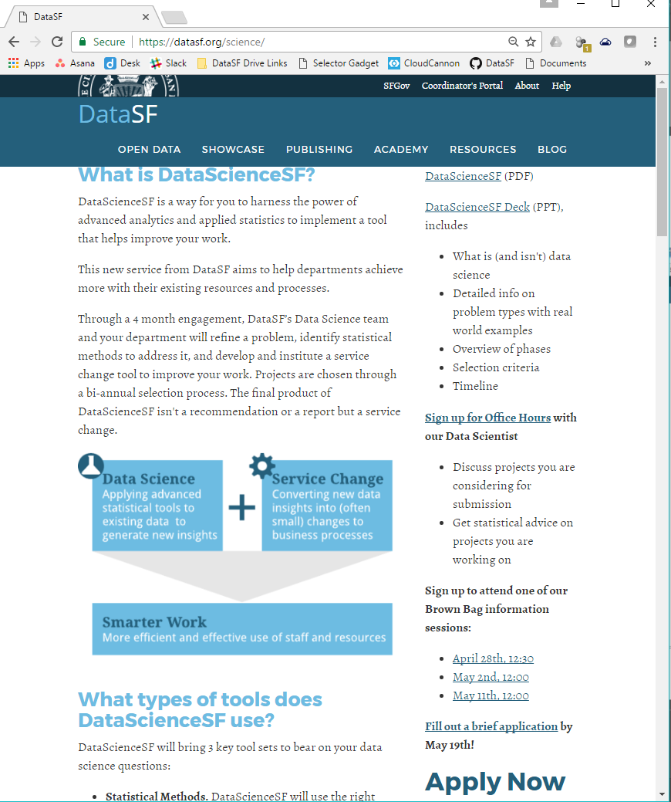
Visit datasf.org/science
At datasf.org/science:
This powerpoint
1 pager
Sign up for office hours
Sign up for brown bag
Apply!

Slide 48

Other Resources: Civic Bridge

Slide 49

Thank yoU @datasf | datasf.org |datasf.org/blog

Slide 50
Activity
Take 5 minutes by yourself
Brainstorm ideas
Take your best idea and complete the form
With your neighbors
Review each top idea and refine/iterate
Report out

